Slide 1

PGDDS – March 2020 Batch Lead Scoring Case Study
Swagat Sahoo
Ramesh Chandra

Slide 2
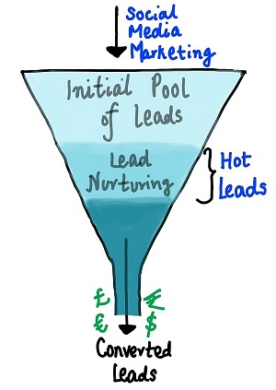
Details of Case Study- Lead Scoring Case Study
Business Understanding
An education company named X Education sells online courses to industry
professionals.
Typical lead conversion is at 30%
Business Objectives
Increase the lead conversion from 30% to 80%
Current lead conversion is 30%
Building the right model to identify and classify the most potential leads tagged
as ”Hot Leads”
Typical Structure of
lead to conversion
Notes:
Typical Structure of lead to conversion

Slide 3
Approach to solve the Case Study
Data Understanding
Data Cleaning
Exploratory Data Analysis
Model Building
Feature Scaling
Data Preparation
Confusion Matrix
&
ROC Curve
Find Optimal Cut-off
Precision
Recall
Final Conclusion

Slide 4
Data Understanding & Cleaning
Total Rows – 9240
Total columns- 37
Converting “Select” to “Null” (“Select” implies that user has not selected any value)
The outlier treatment is not done, as it can impact Lead Conversion
Drop all the data with more than 70% of Null Value
Imputing the “NULL” across different variables, with respective values
Converting categorical variables to dummy features
Test - train split of the data
Data standardization, and dropping variables in scenarios showing highly co-related variables

Slide 5
Logistic Regression Model
S.No | Features | coef | std err | z | P>|z| | VIF
1 | const | -2.1281 | 0.217 | -9.808 | 0
2 | Lead Origin_Lead Add Form | 1.0531 | 0.36 | 2.925 | 0.003 | 0.67
3 | Lead Source_Welingak Website | 3.3847 | 0.817 | 4.144 | 0 | 1.36
4 | Last Activity_Email Bounced | -1.6736 | 0.406 | -4.123 | 0 | 1.06
5 | What is your current occupation_Working Professional | 1.2999 | 0.288 | 4.515 | 0 | 0.59
6 | Tags_Busy | 3.8426 | 0.33 | 11.651 | 0 | 1.11
7 | Tags_Closed by Horizzon | 8.0081 | 0.763 | 10.496 | 0 | 1.15
8 | Tags_Lost to EINS | 9.219 | 0.755 | 12.218 | 0 | 1.05
9 | Tags_Ringing | -1.6855 | 0.336 | -5.022 | 0 | 0.1
10 | Tags_Will revert after reading the email | 3.9804 | 0.23 | 17.319 | 0 | 0.13
11 | Tags_switched off | -2.345 | 0.584 | -4.017 | 0 | 1.04
12 | Lead Quality_Not Sure | -3.3511 | 0.128 | -26.149 | 0 | 1.1
13 | Lead Quality_Worst | -3.8041 | 0.845 | -4.501 | 0 | 1.02
14 | Last Notable Activity_SMS Sent | 2.6987 | 0.119 | 22.675 | 0 | 0.15
After EDA, Logistic Regression Model is built in python using GLM() function, under statsmodel library
The model contained all the variables, some of which had insignificant coefficients
Such variables are removed using
Automated Approach: RFE (Recursive feature elimination) with number of features = 15.
Manual approach based on VIFs and p-values.
The final tally of variables with their respective values
Significant p-values near to zero
VIFs < 3

Slide 6
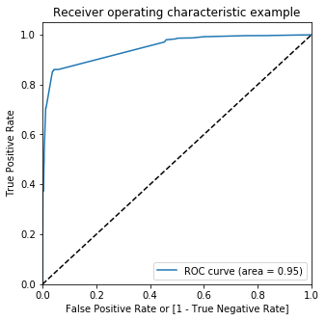
ROC Curve
ROC Curve demonstrates
Tradeoff between sensitivity and specificity
Closer the curve follows the left-hand border and then the top border of ROC space, the more accurate the test
Closer the curve comes to 45° diagonal of the ROC space, the less accurate the test
For our model, ROC curve is towards the upper left corner, and area under the curve is more as displayed in the picture Thus, our model is an optimal choice to move forward with the analysis

Slide 7
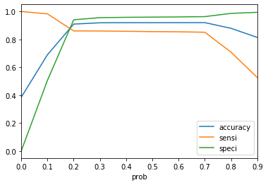
Finding Optimal Cut-off point
Plotting accuracy, sensitivity and specificity for various probabilities.
Cut-Off point is ~0.20, where all three coincide, resulting:
Specifity: ~94%
Sensitivity: ~86%
Accuracy: ~92%
False Positive rate: ~6%
Positive Predicted Value: ~90%
Negative Predicted Value: ~91%
Precision: ~93%
Recall: ~85%

Slide 8
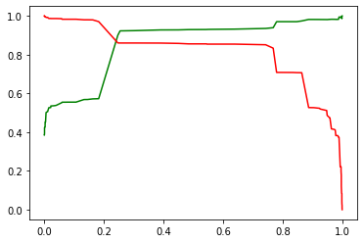
Model Evaluation: Precision and Recall
As per business requirement, we
have chosen 0.20 as a Cut-Off value,
which gives better results for both
accuracy and precision
Accuracy: ~92%
Precision: ~93%
Recall: ~85%
The graph shows a trade-off between Precision and Recall

Slide 9
Prediction on Test Data
With a chosen cut-off value of 0.20 ; we get below results
Sensitivity: ~ 84%
Specifity :~ 94%
False Positive rate :~ 6%
Positive Predictive Value:~ 89%
Negative Predictive Value:~ 91%
Precision: ~93%
Recall: ~85%
As Precision (positive predicted value) > 80%, we can use the same model for
achieving our objective of increasing the conversion rate
Actual/Predicted | Non-Converted | Converted
Non-Converted | 1634 | 100
Converted | 154 | 835

Slide 10
Top-3 Variables
Top 3 Contributing Variables
Top 3 Categorical Dummy Variables
Lead Origin
Lead Origin_Lead Add Form
Actually Lead Origin is the one of the important parameter to keep flowing the funnel for sales team
Lead Source
Lead Source_Welingak Website
This is again important as we understand which source has given us more conversion so we need to constantly monitor & increase the flow from that source
Last activity
Few activity is highly notable primary email read & sms sent
Last Notable Activity SMS Sent
This actually help us to identify the action of the student & understand the interest & pitch accordingly
What is your current occupation Working Professional
This will help to pitch the wrote course to the particular student
Tags Will revert after reading the email.
This action shows the interest of the student

Slide 11
Final Conclusion
The model is prepared for prediction of the conversion of the leads. The probability values are generated by the model. The cutoff decided for the model is 0.20. All leads whose probability is generated above this threshold value can be classified as Hot Lead.
Our focus should be very high on
Lead Source
Lead Origin
We should plan some additional marketing activity on these variables
Our focus are really less on reference program we need to build strategy to bring more candidate through reference as acquisition cost from this model will be less than all other model

Slide 12


